Slide 1
Classifying Fetal Health Using Cardiotocogram Data
Saving lives by
intervening Early
BIT5534 – Spring 2023
Group 8

Slide 2

Business Problem
Reducing child mortality rates is a critical measure of human progress, and many would argue a moral obligation
Neonatal mortality is demonstrably higher in less-developed countries*
Neonatal and under-five mortality rates can be greatly reduced by access to proper medical care*
A solution is needed to assist over-subscribed and under-funded medical staff
Cardiotocogram machines are cheap, reliable and provide a wealth of information on fetal health – can CTG data be used to reliably identify abnormal fetal health?
*per the UN Inter-agency Group for Child Mortality

Slide 3

Data Description
Our data includes the results of Cardiotocography (CTG)
Our data is obtained from Fetal Health Classification | Kaggle.
2126 records of 21 independent attributes
Our data :
  No missing value
  fetal_health = Target variable, binary
  one attribute, histogram_tendency, is categorical
  Two attributes, histogram_number_of_peaks and histogram_number_of_zeroes, are discrete numeric ordinals
  The other 17 attributes are continuous numerical values

Slide 4
Data Transformation
Baseline_value | Numeric Continuous | Fetal heart rate (FHR) baseline in beats per minute
Accelerations | Numeric Continuous | Number of abrupt heartbeat accelerations per second
Fetal_movement | Numeric Continuous | Number of fetal movements per second
Uterine_contractions | Numeric Continuous | Number of uterine contractions per second
Light_decelerations | Numeric Continuous | Number of abrupt light heartbeat decelerations per second
Severe_decelerations | Numeric Continuous | Number of abrupt severe heartbeat decelerations per second
Prolongued_decelerations | Numeric Continuous | Number of decelerations lasting an abnormal amount of time (per second)
Abnormal_short_term_variability | Numeric Continuous | Percentage of time with abnormal short-term variability in FHR
mean_value_of_short_term_variability | Numeric Continuous | Mean short-term variability in FHR
percentage_of_time_with_abnormal_long_term_variability | Numeric Continuous | Percentage of time FHR demonstrated abnormal variability
mean_value_of_long_term_variability | Numeric Continuous | Mean long-term variability of FHR
histogram_width | Numeric Continuous | Width of FHR histogram – how long the Cardiotocogram (CTG) ran
histogram_min | Numeric Continuous | Minimum FHR during the session
histogram_max | Numeric Continuous | Maximum FHR during the session
histogram_mode | Numeric Continuous | Mode of FHR during the session
histogram_mean | Numeric Continuous | Mean of FHR during the session
histogram_median | Numeric Continuous | Median of FHR during the session
histogram_variance | Numeric Continuous | Variance of FHR during the session
  fetal_health = transformed from categorical target to binary variables
  Transformed our target variable to make it binary
  fetal_health2 = denote abnormal fetal health.
    1 = normal, healthy fetus;
    0 = otherwise

Slide 5

Our Approach
CTGs are an accessible and cost-effective tool for evaluating fetal well-being, enabling medical professionals to react quickly to mitigate the risk of maternal and infant mortality.
Our goal is to develop a model based on CTG data attributes that can accurately classify fetal health into a “normal” or “abnormal” category.
A model like this would help healthcare professionals identify and manage high-risk pregnancies early, reducing the maternal and infant mortality and improving overall health outcomes.

Slide 6
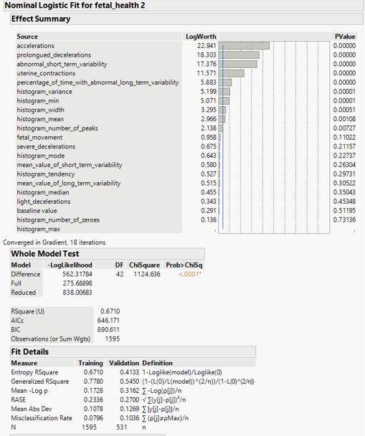
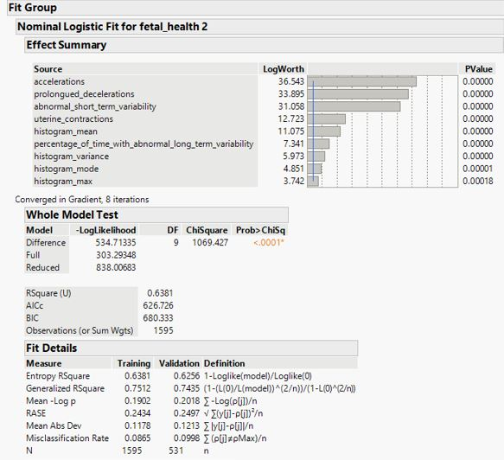
Logistic Regression
Initial Model
Final Model
Number of Predictors : 21
Number of Predictors : 9
Training R2 – 0.78 RASE - 0.23 Misclassification Rate – 8% AUC – 0.97 | Validation R2 - 0.54 RASE - 0.27 Misclassification Rate – 10% AUC – 0.93
Training R2 – 0.75 RASE - 0.24 Misclassification Rate – 8% AUC – 0.97 | Validation R2 - 0.74 RASE – 0.25 Misclassification Rate – 10% AUC – 0.96

Slide 7
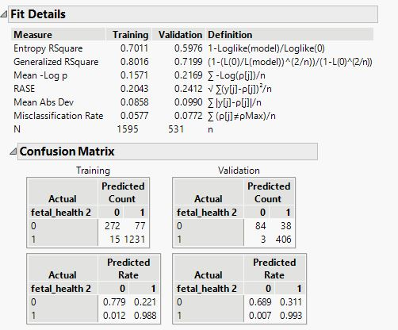
Decision Tree
Method – JMP Partition
Number of Predictors - 9
Automatic Splitting – 75 % for training and 25% for validation
Number of Splits - 13
Summary of Fit:
Training R2 – 0.80 RASE – 0.20 Misclassification Rate – 6% AUC –0.96 | Validation R2- 0.72 RASE- 0.24 Misclassification Rate – 8% AUC – 0.93

Slide 8
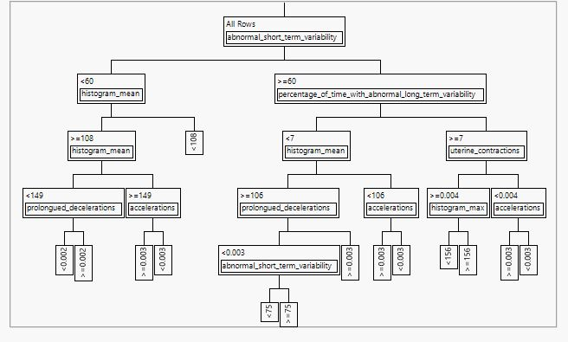
Decision Tree
Small Tree View

Slide 9
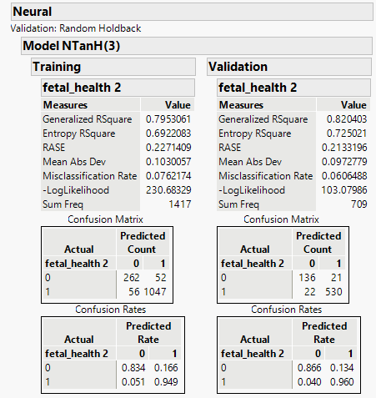
Neural Networks
Methode Used – JMP Neural Networks with Holdback portion of 0.333
Number of Variables Used - 9
Summary of Fit:
Training R2 – 0.79 RASE – 0.23 Misclassification Rate – 7% AUC – 0. 98 | Validation R2- 0.82 RASE- 0.21 Misclassification Rate – 7 % AUC –0.98

Slide 10
Model Comparisons
Model | Measure | Training | Validation
Decision Tree | Generalized R² | 0.8016 | 0.7199
 | RASE | 0.2043 | 0.2412
 | Misclassification Rate | 0.0577 | 0.0772
The Decision Tree model performed well, though fit statistics may indicate overfitting
Logistic Regression performed well without evidence of overfitting. Formula:
16.9477995 + (accelerations * 8.3809162)
+ (uterine_contractions * 273.843857)
- (prolongued_decelerations * 3048.1063)
- (abnormal_short_term_variability * 0.0911936)
- (percentage_of_time_with_abnormal_long_term_ variability * 0.0298157)
– (histogram_max * 0.0302881)
+ (histogram_mode * 0.07520217)
– (histogram_mean * 0.123263)
– (histogram_variance * 0.0320944)
Neural Networks model performed the best with no evidence of overfitting.
Model | Measure | Training | Validation
Logistic Regression | Generalized R² | 0.7512 | 0.7435
 | RASE | 0.2434 | 0.2497
 | Misclassification Rate | 0.0865 | 0.998
Model | Measure | Training | Validation
Neural Networks | Generalized R² | 0.7984 | 0.8191
 | RASE | 0.2232 | 0.2209
 | Misclassification Rate | 0.0708 | 0.0716

Slide 11

Conclusions
CTG Data demonstrates strong correlations with fetal health outcomes
Data modeling techniques can be used to predict abnormal health outcomes with a high degree of accuracy, allowing time for early diagnosis and intervention
Multiple models are available as best fits the needs and capabilities of a provider:
Neural Network - highest predictive performance but requires software to execute
Logistic Regression - very good predictive performance and only requires a mathematical formula to calculate (just addition and multiplication)
Decision Tree – good but not great predictive performance, but a simple flowchart-based model that does not require software or calculations
CTG technology is accessible, inexpensive and provides the data necessary to model fetal health. These models can be used by medical professionals all over the world to help improve health outcomes

